Slide 1
Strategy formulation
Lecture 4

Slide 2
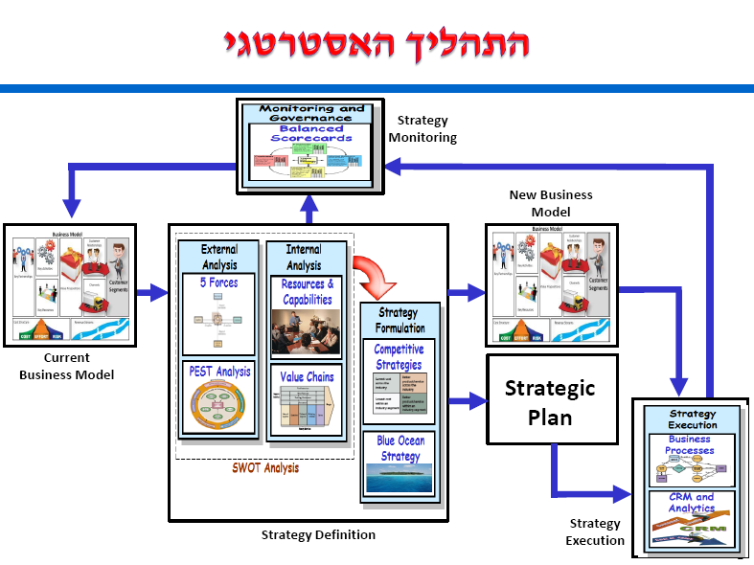

Slide 3
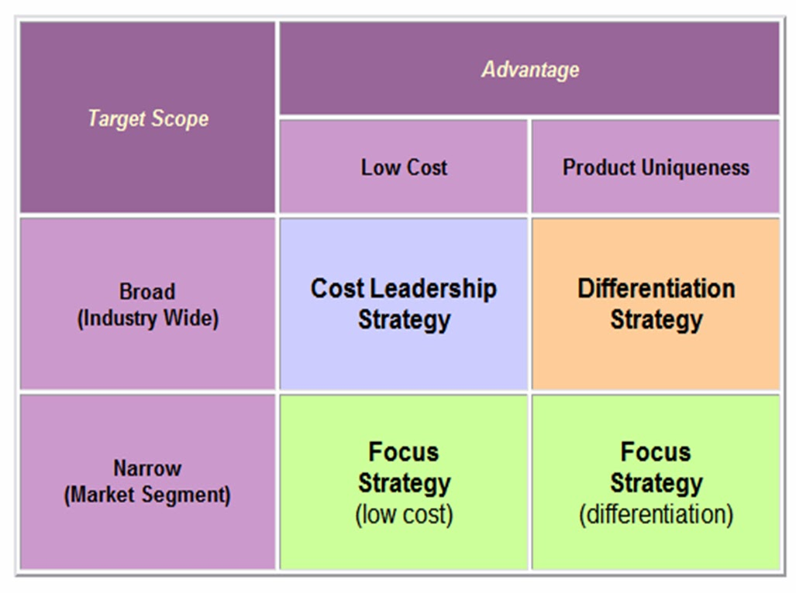
PORTER’S GENERIC STRATEGIES

Slide 4
PORTER’S GENERIC STRATEGIES
An Overall cost leadership strategy is based on:
Creating a low-cost position relative to a firm’s peers
Managing relationships throughout the entire value chain to lower costs
A Differentiation strategy implies:
Products and/or services that are unique & valued
Emphasis on nonprice attributes for which customers will gladly pay a premium
A focus strategy requires:
Narrow product lines, buyer segments, or targeted geographic markets
Advantages obtained either through differentiation or cost leadership

Slide 5
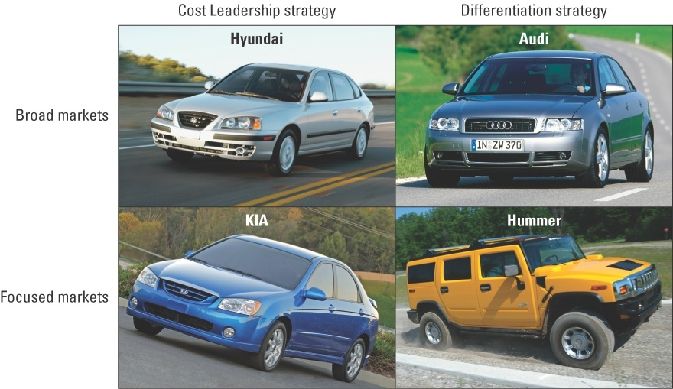
PORTER’S GENERIC STRATEGIES examples

Slide 6


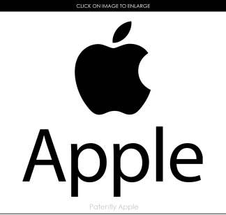

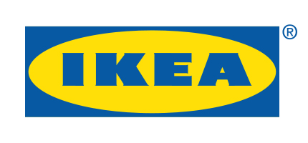
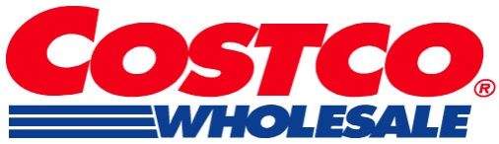
PORTER’S GENERIC STRATEGIES examples
Companies pursuing an overall cost leadership strategy:
Companies pursuing a differentiation strategy:
Companies pursuing a focus strategy:
Notes:
Both McDonald’s and Wal-Mart have paid attention to the value chain. Both have made sourcing of product and distribution of material a key focus of their long-term strategy. By cutting costs of procurement and distribution they have been able to pass these costs along to consumers. (See Case 15: McDonald’s) and Both Apple and Target have made names for themselves by creating products that are unique and desired by the marketplace. Take a look at the TV commercials for both brands. These commercials are creative and innovative: mirroring the attributes of the products they sell. (See Case 6: Apple) Both Ikea – a maker of furniture targeting first-time buyers – and Costco – a big-box retailer targeting the small business owner – have used cost leadership and a focus on a specific consumer to excel in their respective industries. (For a possible example in the grocery industry, see Case 30: Fresh Direct)

Slide 7
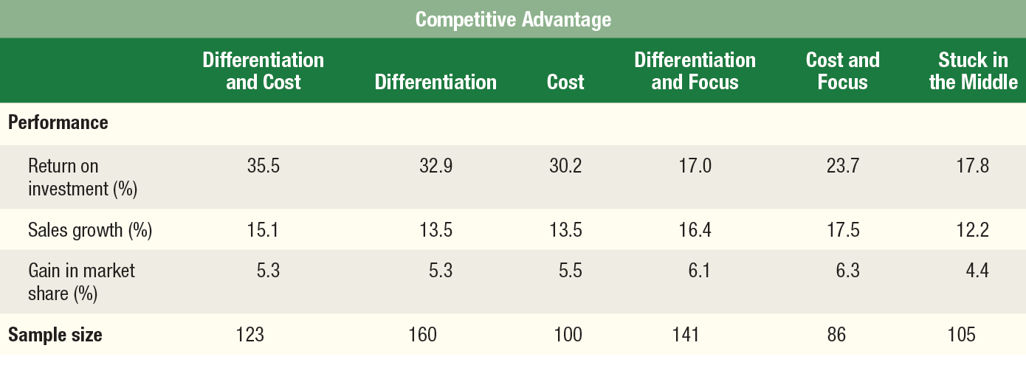
Three Generic Strategies Competitive Advantage and Business Performance
Firms that identify competitive advantage outperform those that do not.
Businesses combining multiple forms of competitive advantage outperformed businesses that used only a single form.
The lowest performers were those that did not identify with any type of advantage. They were classified as “stuck in the middle”.
Notes:
Both casual observation and research supports the notion that firms that identify with one or more of the forms of competitive advantage outperform those that do not. According to the above study, businesses combining multiple forms of competitive advantage (differentiation and overall cost leadership) outperformed businesses that used only a single form. The lowest performers were those that did not identify with any type of advantage. They were classified as “stuck in the middle”.

Slide 8
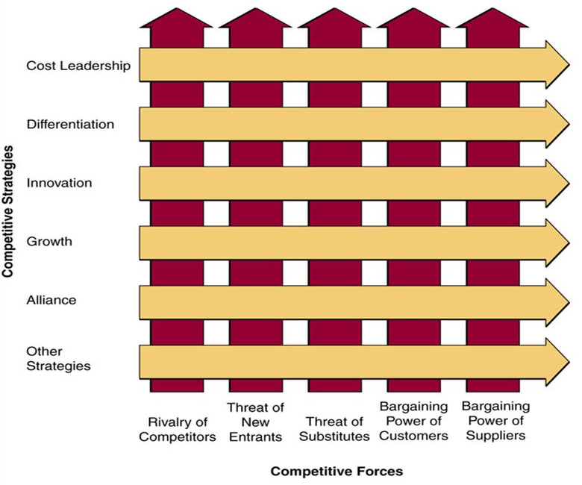
Porter’s competitive forces model

Slide 9
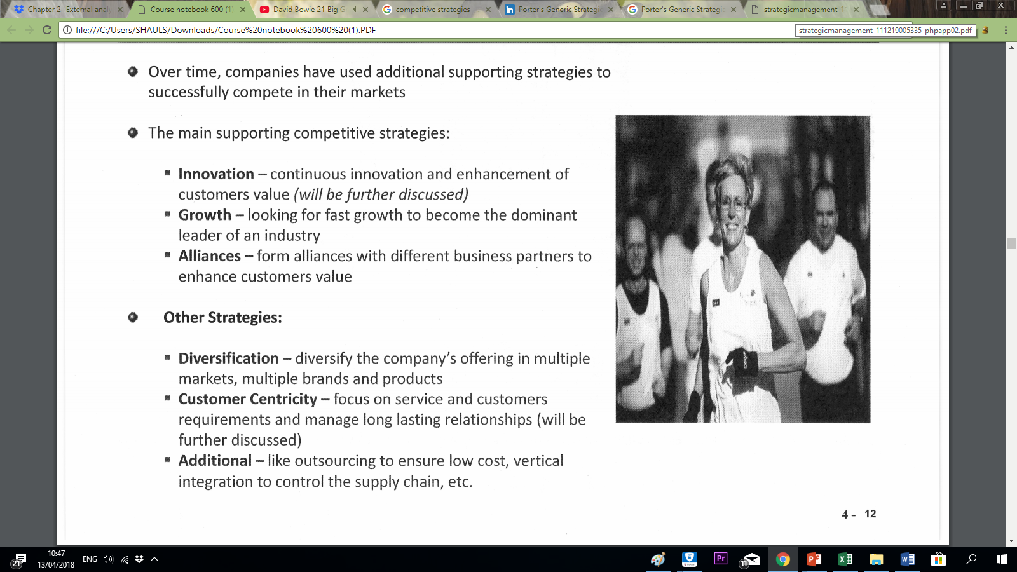
Porter’s competitive forces model

Slide 10
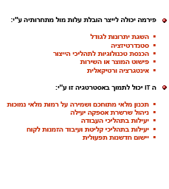
Cost leadership strategy

Slide 11
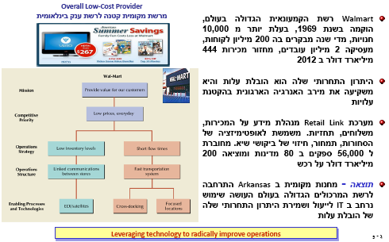
Cost leadership strategy Walmart case study

Slide 12
Pitfalls of Cost Leadership
Too much focus on one or a few value chain activities.
Increase in the cost of the inputs on which the advantage is based
The strategy is imitated too easily
A lack of parity on differentiation
Reduced flexibility
Obsolescence of the basis of a cost advantage
Notes:
Firms need to pay attention to all activities in the value chain. Managers should explore all value chain activities, including relationships among them, as candidates for cost reductions. Firms can also be vulnerable to price increases in the factors of production. A firm’s strategy may consist of value-creating activities that are easy to imitate. Firms striving to attain cost leadership advantages must obtain a level of parity on differentiation. Building a low-cost advantage often requires significant investments in plant and equipment, distribution systems, and large, economically scaled operations. As result, firms often find that these investments limit their flexibility. As a result they have difficulty responding to changes in the environment. Ultimately, the foundation of the firm’s cost advantage may become obsolete. In these circumstances, other firms develop new ways of cutting costs, leaving the old cost-leaders at a significant disadvantage. See Cases 31 & 32: General Motors, & Ford.

Slide 13
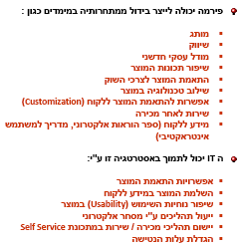
Differentiation strategy

Slide 14
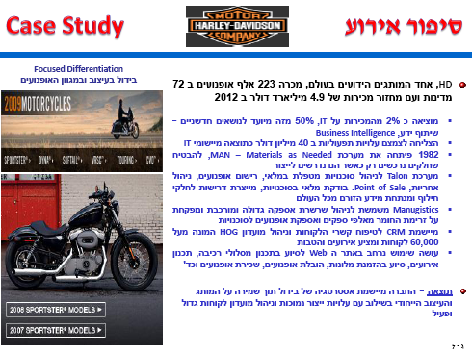
Differentiation strategy HD case study

Slide 15
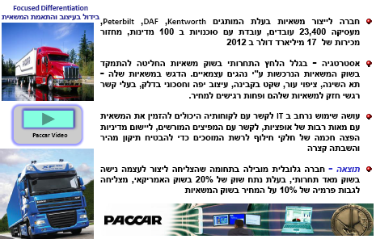
Focus (differentiation) strategy PACCAR case study

Slide 16
Pitfalls of Differentiation
Uniqueness that is not valuable
Too much differentiation
Too high a price premium
Differentiation that is easily imitated
Dilution of brand identification through product line extensions
Perceptions of differentiation may vary between buyers and sellers
Notes:
It’s not enough just to be different. A differentiation strategy must provide unique bundles of products and/or services that customers value highly. Firms may also strive for quality of service that is higher than customers desire thus they become vulnerable to competitors who provide an appropriate level of quality at a lower price. In addition customers may desire the product but are repelled by the price premium. Differentiation advantages can be eroded through imitation. Firms may also erode their quality brand image by adding products or services with lower prices and less quality, thus confusing the customer. (For instance, see Case 9: Ann Taylor – what IS the difference between Ann Taylor and LOFT?) Companies must also realize that although they may perceive their products and services as differentiated, their customers may view them as commodities.

Slide 17
Combination Strategies: Integrating Low-Cost & Differentiation
Integration of low-cost and differentiation strategies makes it difficult for competitors to duplicate or imitate strategy
The goal of a combination strategy is to provide unique value in an efficient manner
Notes:
Combination strategies = firms’ integrations of various strategies to provide multiple types of value to customers. A combination low-cost and differentiation strategy enables a firm to provide two types of value to customers: differentiated abilities ( e.g., high quality, brand identification, reputation) and lower prices (because of the firm’s lower costs in value creating activities). For example, superior quality can lead to lower costs because of less need for rework in manufacturing, fewer warranty claims, a reduced need for customer service personnel to resolve customer complaints, and so forth.

Slide 18
Combination Strategies
Combining overall low-cost and differentiation strategies can take several forms:
Automated & flexible manufacturing systems allow for mass customization
Exploitation of the profit pool concept creates a competitive advantage
Using information technology, firms can integrate activities throughout the extended value chain
Notes:
Mass customization = a firm’s ability to manufacture unique products in small quantities at low cost. This is facilitated by advances in manufacturing technologies such as CAD/CAM. Nike, Land’s End, Cannondale, and Andersen Windows are given as examples. Profit pool = the total profits in an industry at all points along the industry’s value chain. The structure of the profit pool can be complex. The potential pool of profits will be deeper in some segments of the value chain than others, and the depths will vary within an individual segment. Segment profitability may vary widely by customer group, product category, geographic market, or distribution channel. Additionally, the pattern of profit concentration in an industry is often very different from the pattern of revenue generation. Many firms have also achieved success by integrating activities throughout the extended value chain by using information technology to link their own value change with the value chains of their customers and suppliers.

Slide 19
Improving Competitive Position vis-à-vis the Five Forces
An integrated overall low-cost & differentiation strategy
Creates higher entry barriers due to both cost leadership & differentiation
Can provide higher margins that enable the firm to deal with supplier power
Reduces buyer power because of fewer competitors
An overall value proposition reduces threat from substitutes
Notes:
Firms that successfully integrate both differentiation and cost advantages create an enviable position. This dominant competitive position serves to erect high entry barriers to potential competitors that have neither the financial nor physical resources to compete head-to-head. The organization’s larger size can provide enormous bargaining power over suppliers. Low pricing and wide selection can reduce the power of buyers because there are relatively few competitors that can provide a comparable cost/value proposition. This overall value proposition also makes potential substitute products a less viable threat. Walmart is given as an example.

Slide 20
Pitfalls of Combination Strategies
Firms that fail to attain both overall low-cost & differentiation strategies may end up with neither and become “stuck in the middle”
Firms can also underestimate the challenges & expenses associated with coordinating value-creating activities in the extended value chain
Firms can also miscalculate sources of revenue and profit pools in the firm’s industry
Notes:
A key issue in strategic management is the creation of competitive advantages that enable the firm to enjoy above average returns. Some firms may become “stuck in the middle” if they try to attain both cost and differentiation advantages. While integrating activities across a firm’s value chain, firms must consider the expenses linked to technology and investment, managerial time and commitment, and the involvement and investment required by the firm’s customers and suppliers. The firm must be confident that it can generate a sufficient scale of operations and revenues to justify all associated expenses. Finally, firms may fail to accurately assess sources of revenue and profits in their value chain.

Slide 21
supporting strategy innovation

Slide 22
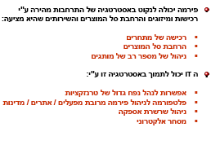
supporting strategy Growth

Slide 23
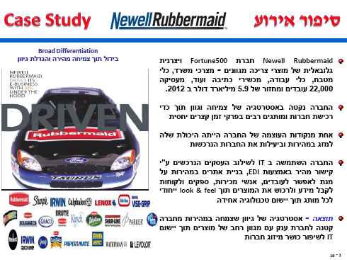
supporting strategy - Growth Newell Rubbermaid case study

Slide 24
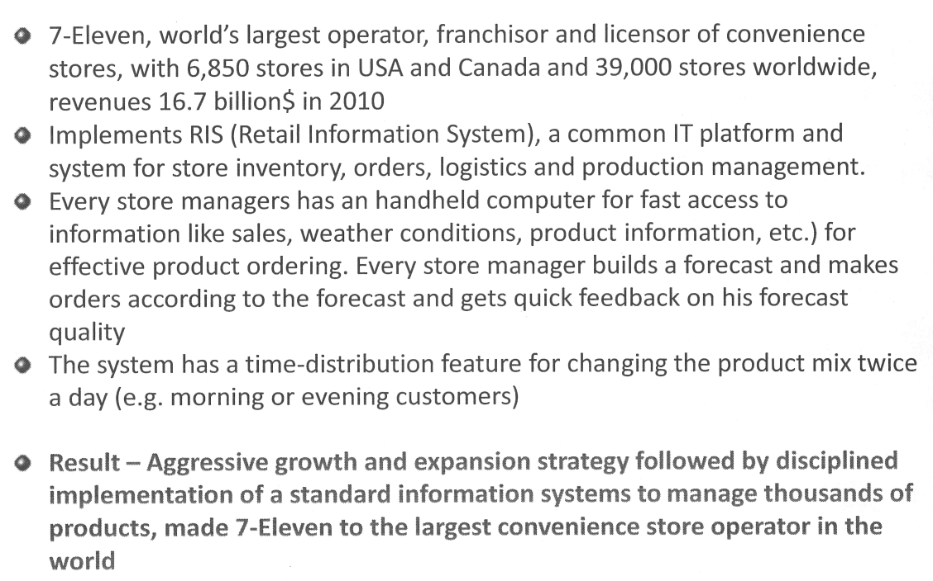
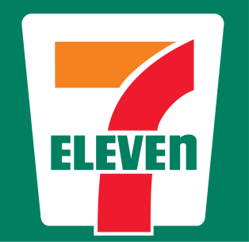
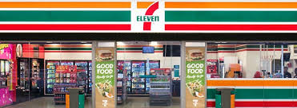
supporting strategy - Growth 7 eleven case study

Slide 25
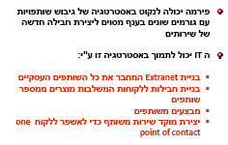
supporting strategy-alliances

Slide 26

supporting strategy-alliances Amadeus case study

Slide 27
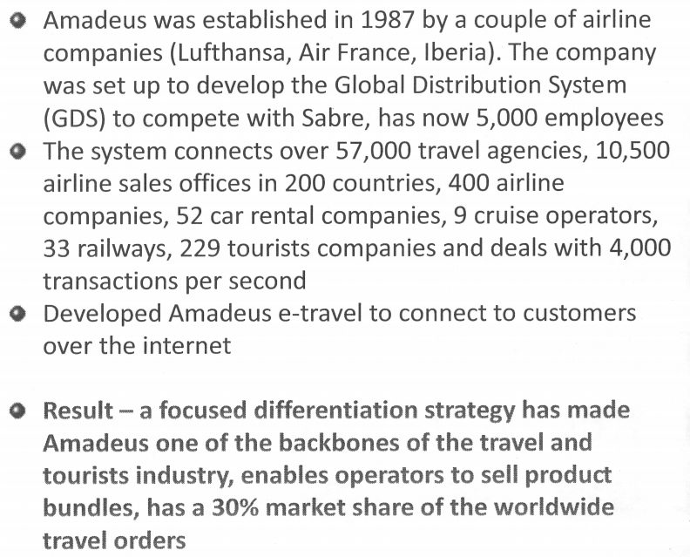
supporting strategy-alliances Amadeus case study

Slide 28

Distruption

Slide 29
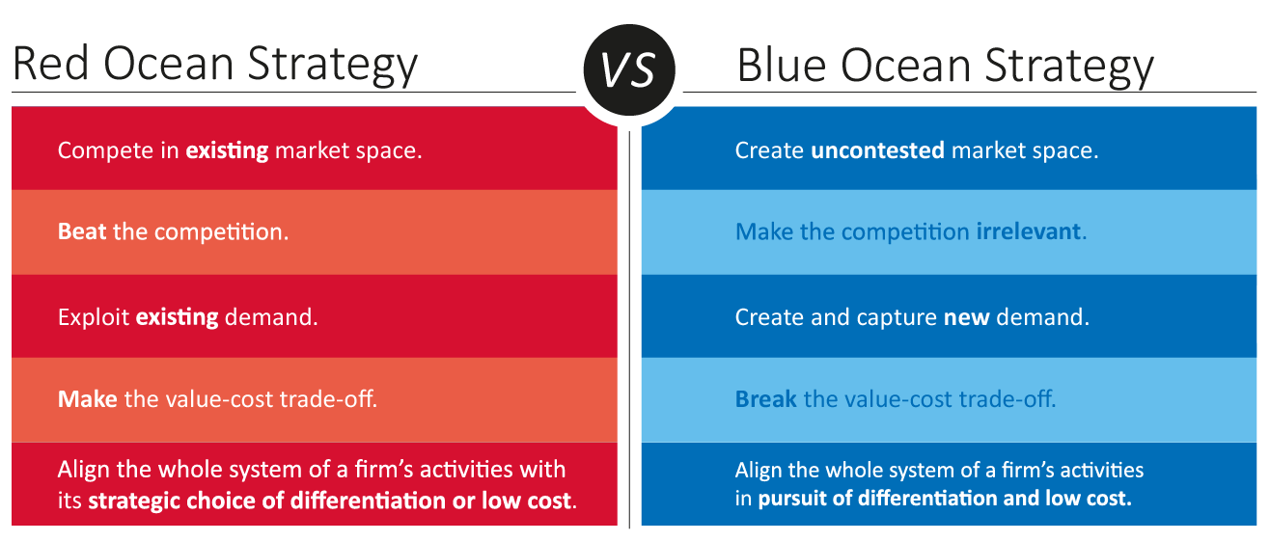
distruption

Slide 30
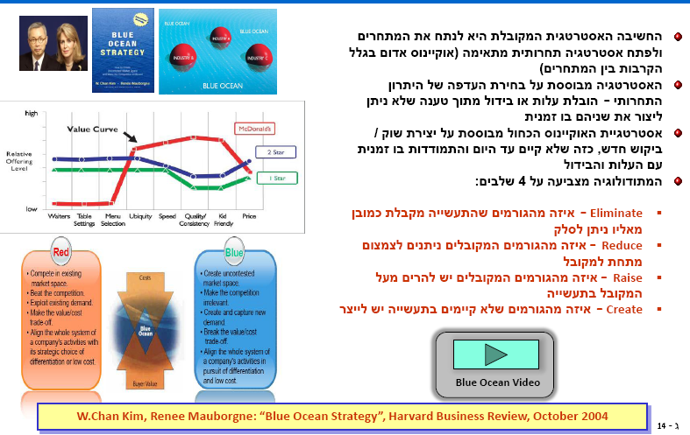

Slide 31
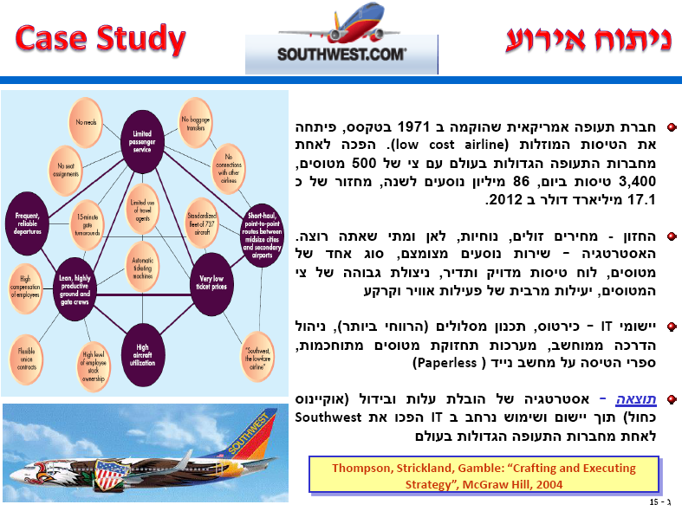

Slide 32
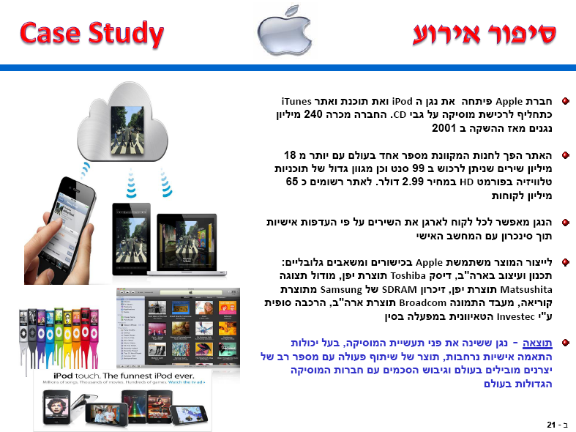
Force – substitutes Strategy= differentiation

Slide 33
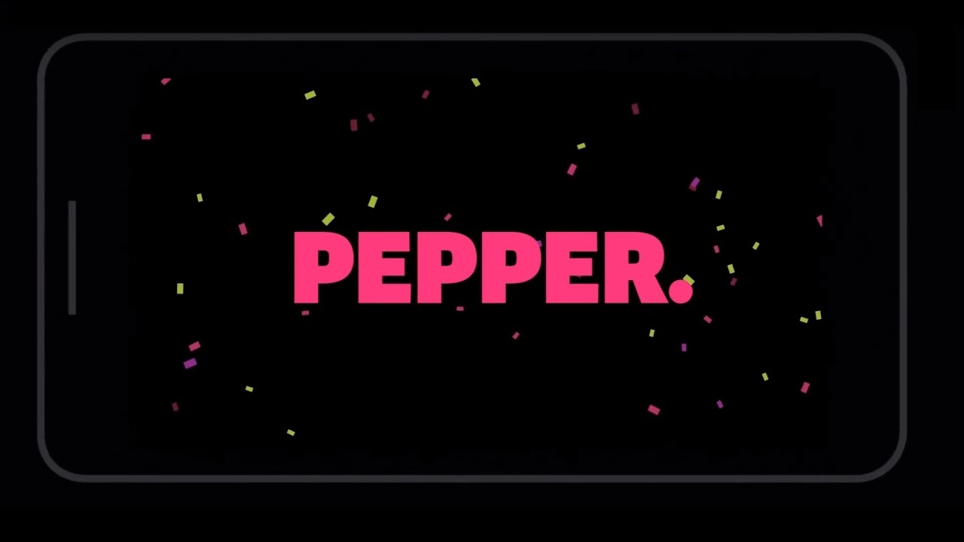

Force – substitutes Strategy= differentiation

Slide 34

Force – substitutes Strategy= differentiation

Slide 35
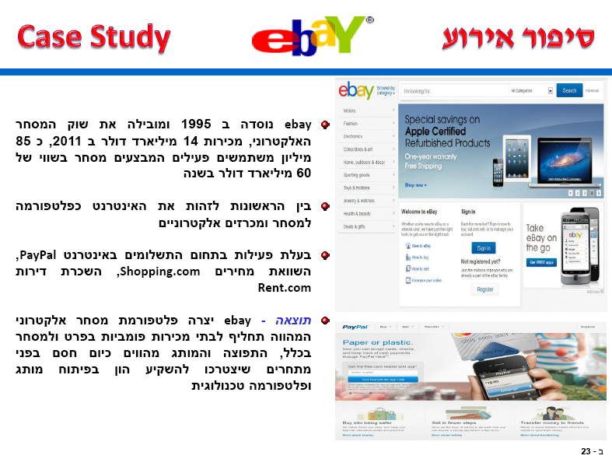
Force – substitutes Strategy= differentiation

Slide 36
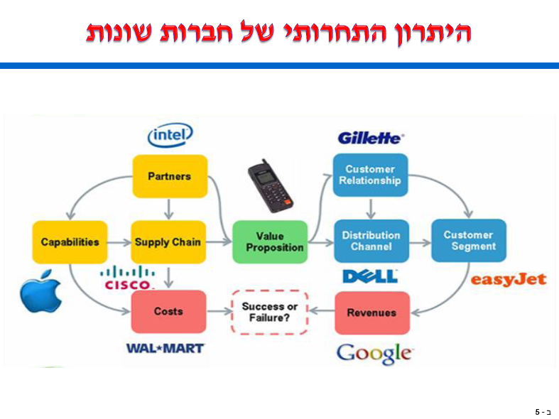

Slide 37
Internet-Enabled Low-Cost Leader Strategies
The Internet and digital technologies lower transaction costs:
No in-person sales calls
Paperless transactions
Disintermediation or removing intermediaries also lowers transaction costs
Reduced search costs
No need for a permanent retail location
Notes:
Digital technologies = information that is in numerical form, which facilitates its storage, transmission, analysis and manipulation. Transaction costs refer to all the various expenses associated with conducting businesses. It applies not just to buy/sell transactions but to the costs of interacting with every part of the firm’s value chain, within and outside the firm. Disintermediation = the process of bypassing buyer channel intermediaries such as wholesalers, distributors, and retailers. Removing intermediaries lowers transaction costs. The Internet reduces the costs to search for a product or service. Not only is the need for travel eliminated but so is the need to maintain a physical address or permanent retail location. However most of the advantages associated with lower transaction costs can be duplicated quickly and without threat of infringement on proprietary information. Companies can also become overly enamored with using the Internet for cost cutting and thus jeopardize customer relations or neglect other cost centers.

Slide 38
Internet-Enabled Differentiation Strategies
The Internet and digital technologies have created new ways of differentiating by enabling mass customization
Customers can judge the quality & uniqueness of a product or service by their ability to be involved in its planning & design
Lowered transaction costs allow firms to achieve parity on cost while providing a unique experience
Notes:
Mass customization has changed how companies go to market. Online customer interaction has replaced the showroom floor. Customers can be involved in planning and design of products and then receive these products quickly with reliable results. Differentiators can make exceptional products and achieve superior service at a reasonable cost, therefore allowing firms to achieve parity on the basis of overall cost leadership as well as differentiation. However, traditional differentiation strategies such as building strong brand identity and prestige pricing have been undermined by Internet-enabled capabilities such as the ability to compare product features side-by-side or bid online for competing services.

Slide 39
Internet-Enabled Focus Strategies
The Internet and digital technologies have created new ways of competing in a narrow market segment
Customers can access markets less expensively, and small firms can extend their reach
Social media allows niche firms to solicit input and respond quickly to customer feedback
Notes:
The Internet offers companies with a focus strategy the ability to access markets less expensively (low-cost) and provide more services and features (differentiation). Niche players can access small markets in a highly specialized fashion. With social media tools, these companies can solicit input, respond quickly to customer feedback, and provide overall improved customer service. However, focusers can misread the scope and interests of their target markets. This can cause them to focus on segments that are too narrow to be profitable, or to lose their uniqueness in an overly broad niche, making them vulnerable to imitators or new entrants. Focusers can also over extend their niche. Offering additional services can cause the company to lose the cost advantages associated with a limited product or service offering.

Slide 40
Internet-Enabled Combination Strategies
The Internet and digital technologies have provided all companies with greater tools for managing costs
With lower costs for all, the net effect is fewer rather than more opportunities for sustainable advantage
The ease of comparison shopping also erodes differentiation advantages
Notes:
The Internet has provided all companies with greater tools for managing costs. However, for individual companies, it may shave critical percentage points off profit margins and create a climate that makes it impossible to survive, much less achieve sustainable above-average profits. The differentiation advantage is also diminished by the Internet because of the ability to comparison shop. A combination strategy challenges a company to carefully blend alternative strategic approaches and remain mindful of the impact of different decisions on the firm’s value-creating processes and its extended value chain entities. Strong leadership is needed to coordinate the multiple dimensions of a combination strategy.

Slide 41
Industry Life Cycle Stages
The industry life cycle
Introduction
Growth
Maturity
Decline
Generic strategies, value-creating activities, & overall objectives all vary over the course of an industry life cycle
Notes:
Industry life cycle = the stages of introduction, growth, maturity, and decline that typically occur over the life of an industry. Managers must become even more aware of their firm’s strengths and weaknesses in many areas to attain competitive advantages. Factors such as generic strategies, market growth rate, intensity of competition, and overall objectives can change over the course of an industry life cycle. Managers must strive to emphasize the key functional areas during each of the four stages and to attain a level of parity in all functional areas and value-creating activities. Note: products and services go through many cycles of innovation and renewal. Typically, only fad products have a single lifecycle. Maturity stages of an industry can be transformed or followed by the stage of rapid growth if consumer tastes change, technological innovations take place, or new developments occur.

Slide 42
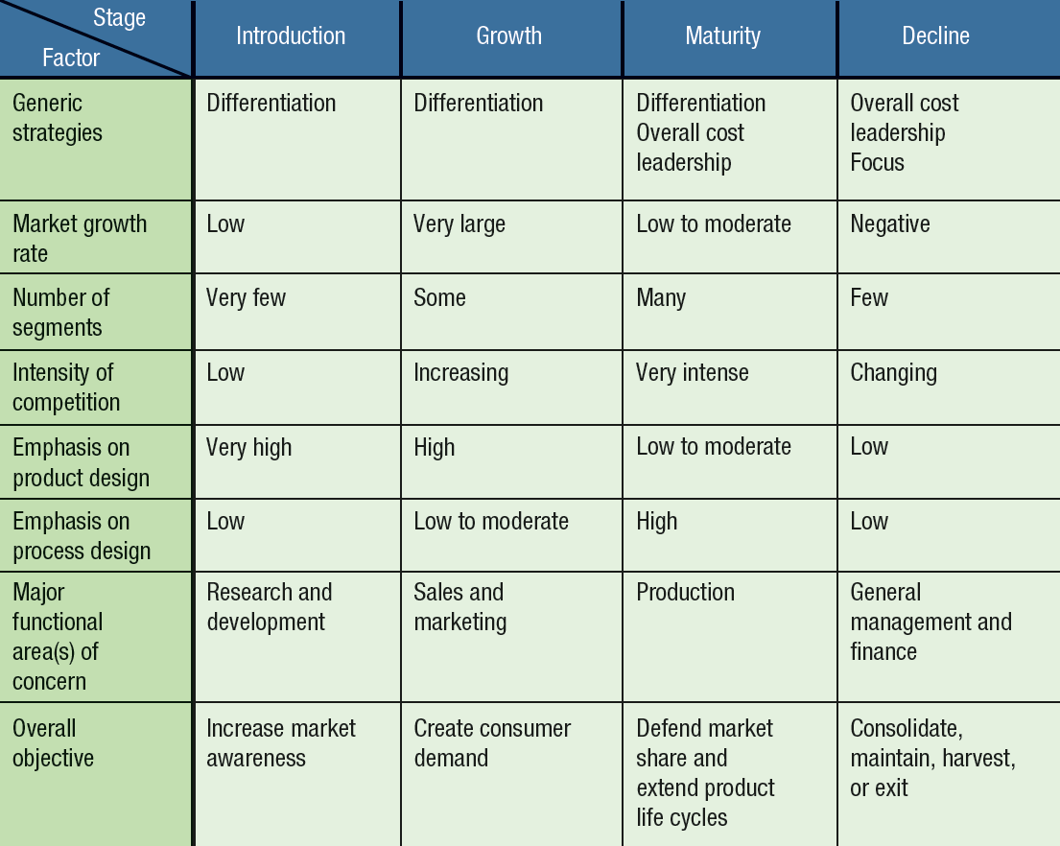
Industry Life Cycle Stages
Notes:
Industry life cycle = the stages of introduction, growth, maturity, and decline that typically occur over the life of an industry.

Slide 43
Strategies in the Introduction Stage
The introduction stage is when:
Products are unfamiliar to consumers
Market segments are not well-defined
Product features are not clearly specified
Competition tends to be limited
Strategies:
Develop a product and get users to try it
Generate exposure so the product becomes “standard”
Notes:
Introduction stage = the first stage of the industry life cycle, characterized by (1) new products that are not known to customers, (2) poorly defined market segments, (3) unspecified product features, (4) low sales growth, (5) rapid technological change, (6) operating losses, and (7) a need for financial support. Since there are few players and not much growth, competition tends to be limited. Success requires an emphasis on research and development and marketing activities to enhance awareness. The challenge becomes one of developing the product and finding a way to get users to try it, and generating enough exposure so the product emerges as the “standard” by which all other rivals’ products are evaluated. There’s an advantage to being the “first mover” in a market.

Slide 44
Strategies in the Growth Stage
The growth stage is:
Characterized by strong increases in sales
Attractive to potential competitors
When firms can build brand recognition
Strategies:
Create branded differentiated products
Stimulate selective demand
Provide financial resources to support value-chain activities
Notes:
Growth stage = the second stage of the product life cycle, characterized by (1) strong increases in sales; (2) growing competition; (3) developing brand recognition; and (4) a need for financing complementary value-chain activities such as marketing, sales, customer service, and research and development. In the growth stage, the primary key to success is to build consumer preferences for specific brands. This requires strong brand recognition, differentiated products, and the financial resources to support a variety of value chain activities such as marketing and sales, and research and development. Efforts in the growth stage are directed towards stimulating selective demand in which a firm’s products offerings are chosen instead of a rival’s. Revenues can increase at an accelerating rate because new consumers are trying the product and a growing proportion of satisfied consumers are making repeat purchases.

Slide 45
Strategies in the Maturity Stage
The maturity stage is when:
Aggregate industry demand slows
Market becomes saturated, few new adopters
Direct competition becomes predominant
Marginal competitors begin to exit
Strategies:
Create efficient manufacturing operations
Lower costs as customers become price-sensitive
Adopt reverse or breakaway positioning
Notes:
Maturity stage = the third stage of the product life cycle, characterized by (1) slowing demand growth, (2) saturated markets, (3) direct competition, (4) price competition, and (5) strategic emphasis on efficient operations. As markets become saturated, there are few new adopters. Rivalry among existing rivals intensifies because of fierce price competition at the same time that expenses associated with attracting new buyers are rising. Advantages based on efficient manufacturing operations and process engineering become more important for keeping costs low as customers become more price sensitive. It also becomes more difficult for firms to differentiate their offerings, because users have a greater understanding of products and services. Firms can affect consumers’ mental shifts through (A) reverse positioning = a break in industry tendency to continuously augment products, characteristics of the product life cycle, by offering products with fewer product attributes and lower prices; or (B) breakaway positioning = a break in industry tendency to incrementally improve products along specific dimensions, characteristic of the product life cycle, by offering products that are still in the industry but that are perceived by customers as being different.

Slide 46
Strategies in the Decline Stage
The decline stage is when:
Industry sales and profits begin to fall
Price competition increases
Industry consolidation occurs
Strategies:
Maintaining the product position
Harvesting profits & reducing costs
Exiting the market
Consolidating or acquiring surviving firms
Notes:
Decline stage = the fourth stage of the product life cycle, characterized by (1) falling sales and profits, (2) increasing price competition, and (3) industry consolidation. Firms must face up to the fundamental strategic choices of either exiting or staying and attempting to consolidate their position in the industry. In the decline stage, a firm’s strategic options become dependent on the actions of rivals. If many competitors leave the market, sales and profit opportunities increase. On the other hand, prospects are limited if all competitors remain. Maintaining refers to keeping a product going without significantly reducing marketing support, technological development, or other investments, in the hope that competitors will eventually exit the market. A harvesting strategy = a strategy of bringing as much profit as possible out of the business in the short to medium term by reducing costs. Exiting the market involves dropping the product from the firm’s portfolio. A consolidation strategy = a firm’s acquiring or merging with other firms in an industry in order to enhance market power and gain valuable assets. Firms can also resurrect old technologies by retreating to more defensible ground, using the new to improve the old, or improving the price-performance trade-off.

Slide 47
Question?
As markets mature,
costs continue to increase.
applications for patents increase
differentiation opportunities increase.
there is increasing emphasis on efficiency.
Notes:
Answer: D. See stages in the maturity cycle.

Slide 48


Turnaround Strategies
A turnaround strategy involves reversing performance decline & reinvigorating growth toward profitability through
Asset & cost surgery
Selected market & product pruning
Piecemeal productivity improvements
Example = Ford Motor Company
Example = Jamba Juice
Notes:
Turnaround strategy = a strategy that reverses a firm’s decline in performance and returns it to growth and profitability. The need for turnaround may occur at any stage in the life cycle but is more likely to occur during maturity or decline. Most turnarounds require a firm to carefully analyze the external and internal environments. The external analysis leads to identification of market segments and customer groups that may still find the product attractive. Internal analysis results in actions aimed at reduced costs and higher efficiency. See Case 32: Ford, and Strategy Spotlight 5.7 for how Alan Mulally lead Ford’s turnaround. See Case 8: Jamba Juice for how CEO James White revamped the product line and put the company on the path to profitability.

